Slide 1
Totalflow R&D Gate Model
Raymond Crow, Bartlesville R&D, 04/25/2012
Overview

Slide 2
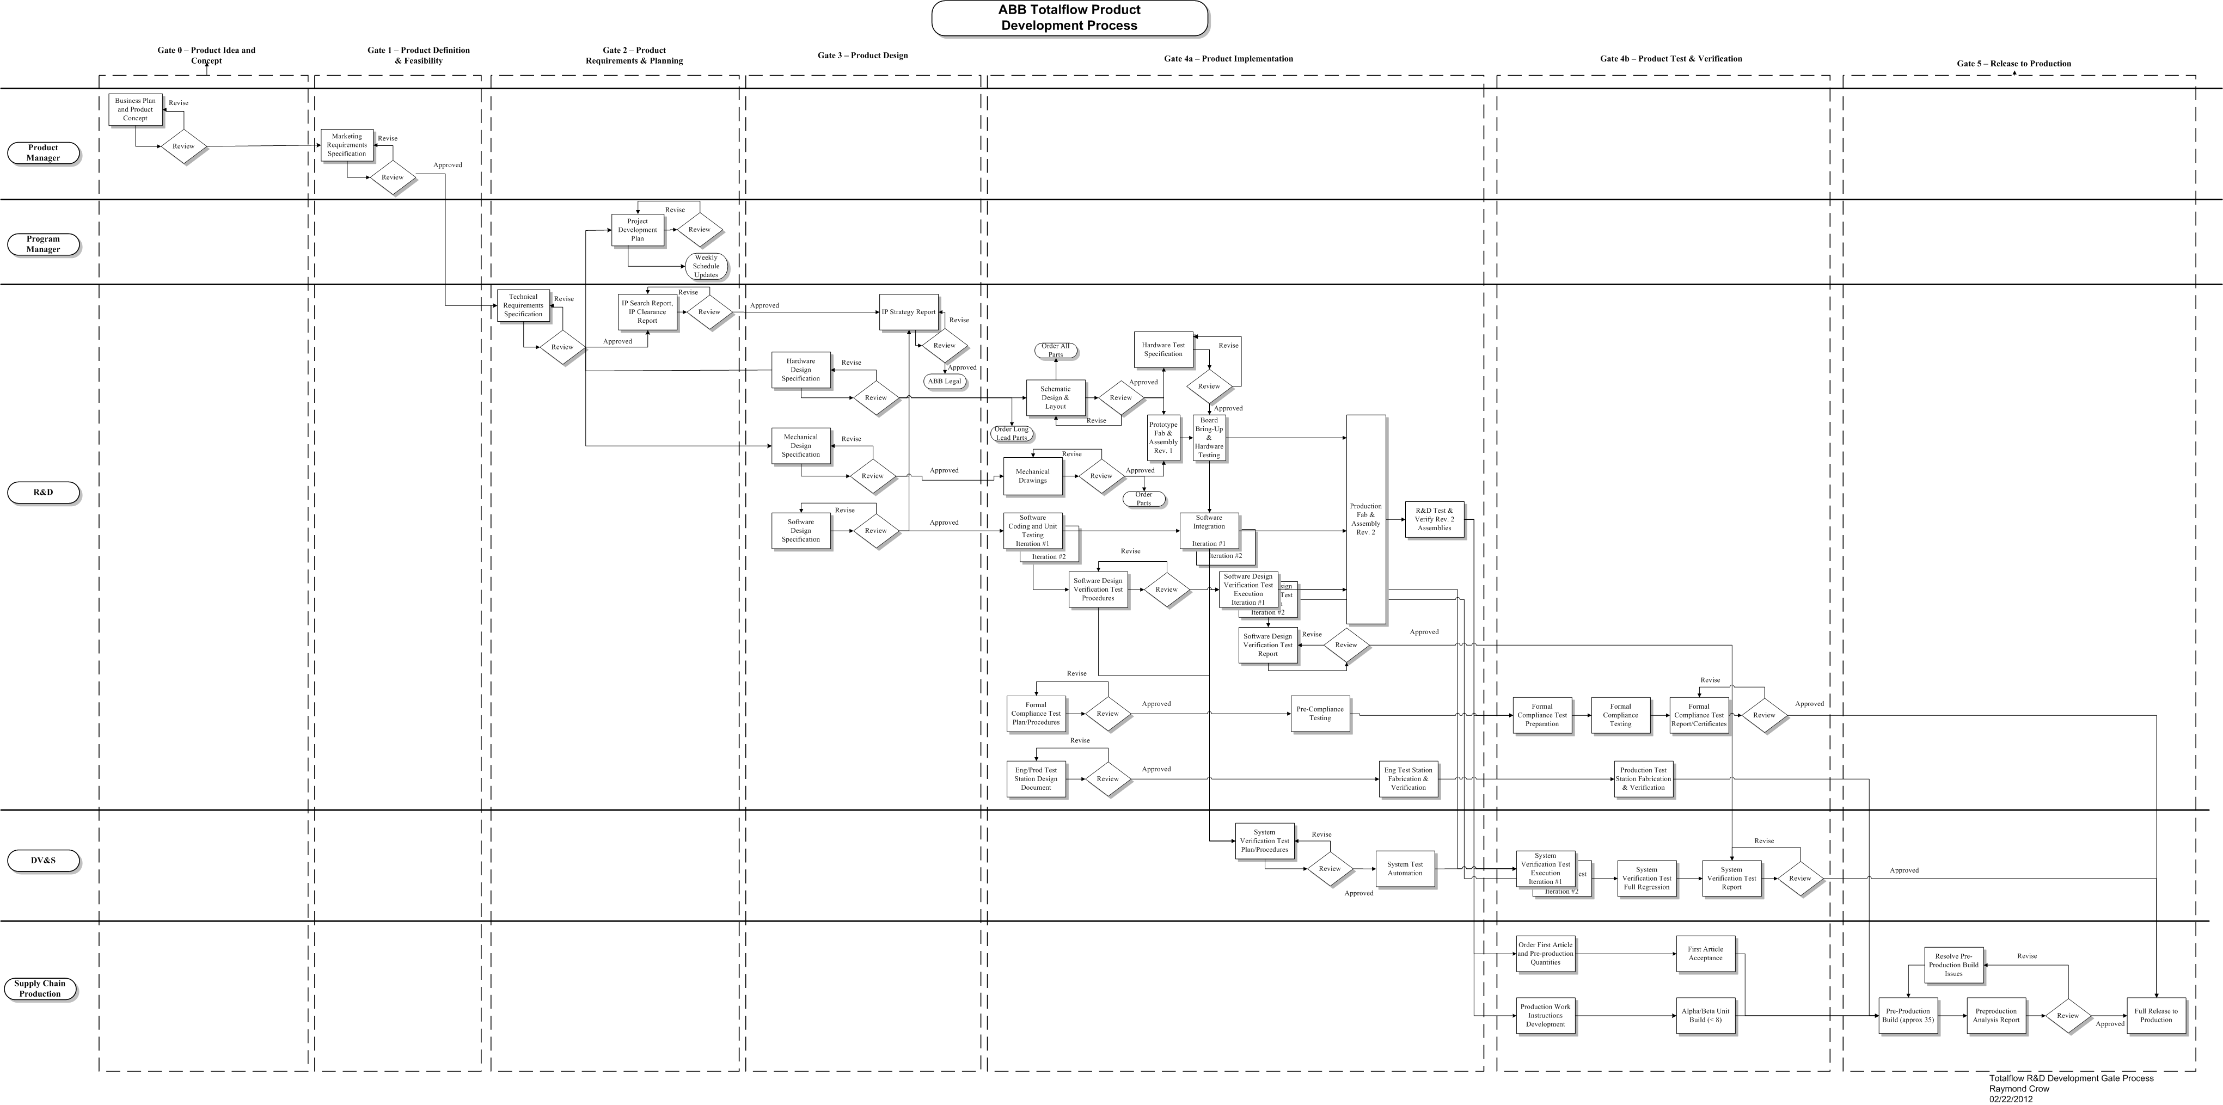
Gate Model Overview
Gate Overview

Slide 3
Gate Model Overview
Gate 0 – Product Idea and Concept
Gate Owner – Product Manager
Business Plan and Product Concept
Product Concept/Vision
Product Portfolio
Key Markets
Migration Strategy
Competitive Analysis
Market Size, Share and Volume
Return on Investment

Slide 4
Gate Model Overview
Gate 1 – Product Definition and Feasibility
Gate Owner – Product Manager
Marketing Requirements Specification

Slide 5
Gate Model Overview
Gate 2 – Product Requirements & Planning
Gate Owner – Program Manager
Technical Requirements Document
Detailed product requirements based on Marketing Requirements Specification
High level architectural solution (Hardware, Software, Mechanical, …)
Traceability back to Marketing Requirements Specification
Architectural trade-offs
Product Development Plan
Development strategy
Resource requirements
Detailed schedule
Development costs
Project risks & mitigation plan
Gate model deviation requests/approval

Slide 6
Gate Model Overview
Gate 2 – Product Requirements & Planning (continued)
Gate Owner – Program Manager
Intellectual Property Research Document
Prior art search report

Slide 7
Gate Model Overview
Gate 3 – Product Design
Gate Owner – Research and Development
Hardware Design Specification
Hardware Block Diagram
Detailed Hardware Block Descriptions
Detailed Hardware Physical Interface Descriptions
Software Interface Descriptions
Design Trade-off Analysis
Traceability to Technical Requirements Document
Software Design Specification
Software Block Diagram
Detailed Design
Software Interface Specification
Memory and Processing requirements.
Design Trade-off Analysis
Traceability to Technical Requirements Document

Slide 8
Gate Model Overview
Gate 3 – Product Design (Continued)
Gate Owner – Research and Development
Mechanical Design Specification
Mechanical Component Definition
Detailed Design
Design Trade-off Analysis
Traceability to Technical Requirements Document
Intellectual Property Technical Definition Document
Detailed Intellectual Property declaration
Coordination with Legal for preliminary patent submission.

Slide 9
Gate Model Overview
Gate 4a – Product Implementation
Gate Owner – Research and Development
Hardware
Schematic design
Board layout
Hardware test specification
Rev 1 board prototype build
Board bring-up and testing
Rev 2 clean-up, build and re-test.
Software
Code and unit testing
Integration testing (white box)
Software design verification testing (white & black box testing)
Mechanical
Fabrication, Assembly, Spare Parts, … drawings
Rev 1 mechanical assemblies
Rev 2 clean-up, build and retest mechanical assemblies

Slide 10
Gate Model Overview
Gate 4a – Product Implementation (continued)
Gate Owner – Research and Development
Compliance
Formal compliance test plan/procedures
Pre-compliance testing
Test Station
Engineering Test Station Design
Engineering Test Station Implementation
System/Quality Testing
System Test Plan/Procedures (Black box testing – requirements)
System Automation Test development.

Slide 11
Gate Model Overview
Gate 4b – Product Test and Verification
Gate Owner – Research and Development
Compliance
Formal Compliance Test Execution/Report
Test Station
Production Test Station Implementation
System/Quality Testing
System Verification Test Execution – Multiple iterations
System Verification Test Report
Supply Chain
Order First Article/Pre-production Quantities
First Article Acceptance
Production
Production Work Instruction Development
Alpha/Beta Unit Build/Fabrication

Slide 12
Gate Model Overview
Gate 5 – Release to Production
Gate Owner – Research and Development
Supply Chain
Supply Chain Preparation for Full Release
Production
Pre-Production Build and Preparation for Full Release

